Slide 1
Transfer Learning
A Deep Learning Approach

Slide 2
Index
What is Transfer Learning?
Why Transfer Learning?
Approach Categories
Deep Neural Networks
Convolutional Based Transfer
Resources
Q&A

Slide 3
What is Transfer Learning?
Definitions
Transfer learning is the improvement of learning in a new task through the transfer of knowledge from a related task that has already been learned.
— Chapter 11: Transfer Learning, Handbook of Research on Machine Learning Applications, 2009.
Transfer learning and domain adaptation refer to the situation where what has been learned in one setting … is exploited to improve generalization in another setting
— Page 526, Deep Learning, 2016.

Slide 4
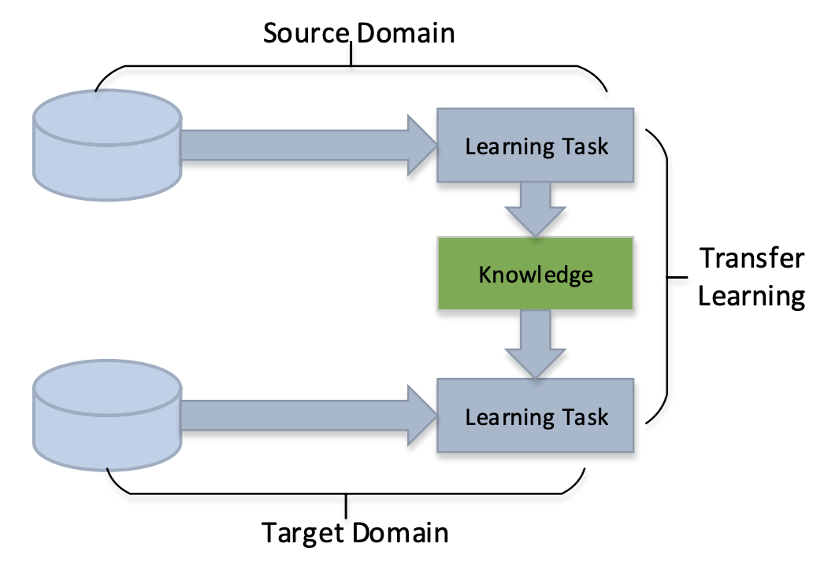
What is Transfer Learning?
Description
Notes:
Let us assume that a task is the objective our model aims to perform, e.g. recognize objects in images, and a domain is where our data is coming from, e.g. images taken in San Francisco coffee shops.

Slide 5
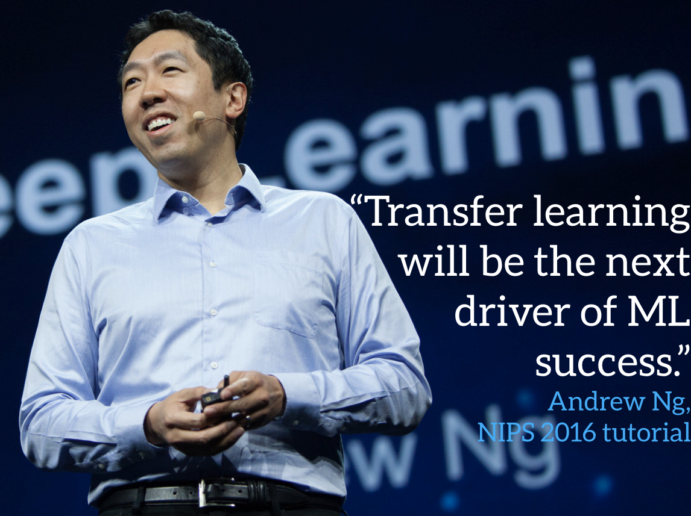
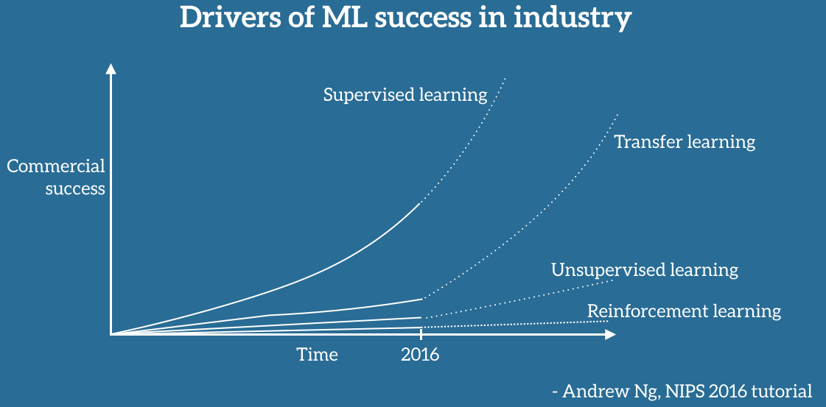
Why Transfer Learning?
Commercial Success
Notes:
It is indisputable that ML use and success in industry has so far been mostly driven by supervised learning.

Slide 6
Why Transfer Learning?
Supervised Learning Success
Domains/Tasks:
Object recognition
Speech recognition
Skin cancer detection
Drivers:
Advances in Deep Learning
More capable computing utilities (GPUs, TPUs, Cloud Services…)
LARGE LABELED datasets

Slide 7
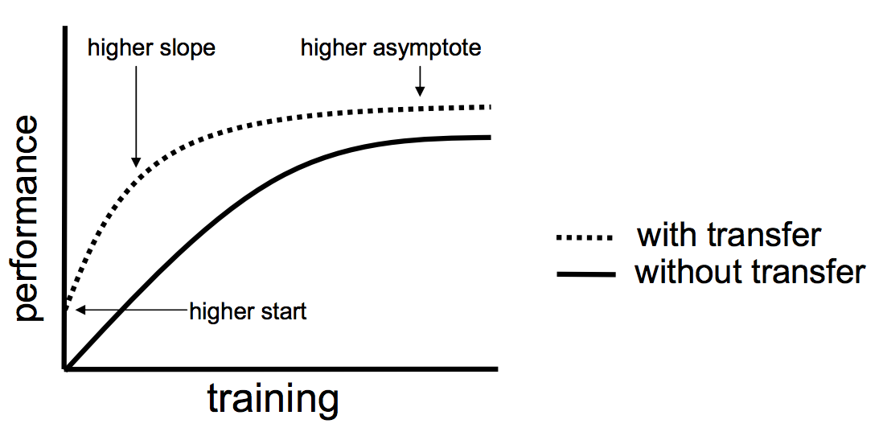
Why Transfer Learning?
Main Benefits
Save training time.
No need for a LARGE labeled dataset.
The model performs better in most of the cases:
Higher start
Higher slope
Higher asymptote

Slide 8
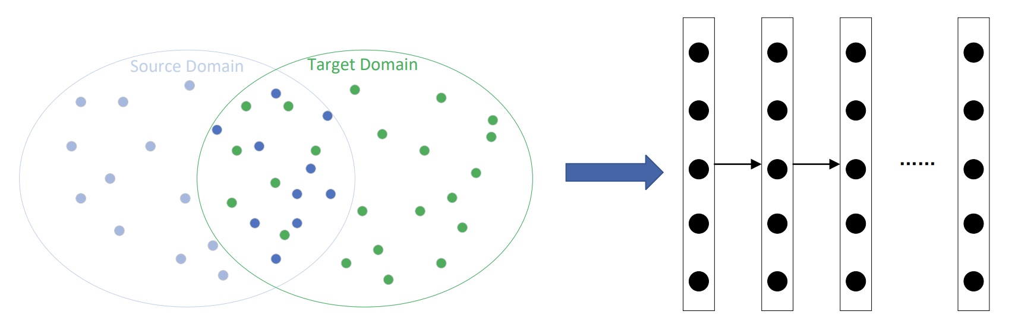
Approach Categories
Instances-based

Slide 9
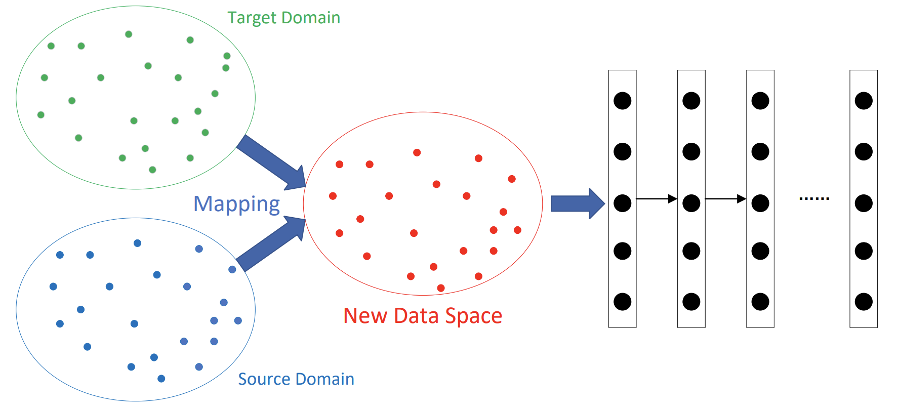
Approach Categories
Mapping-based

Slide 10
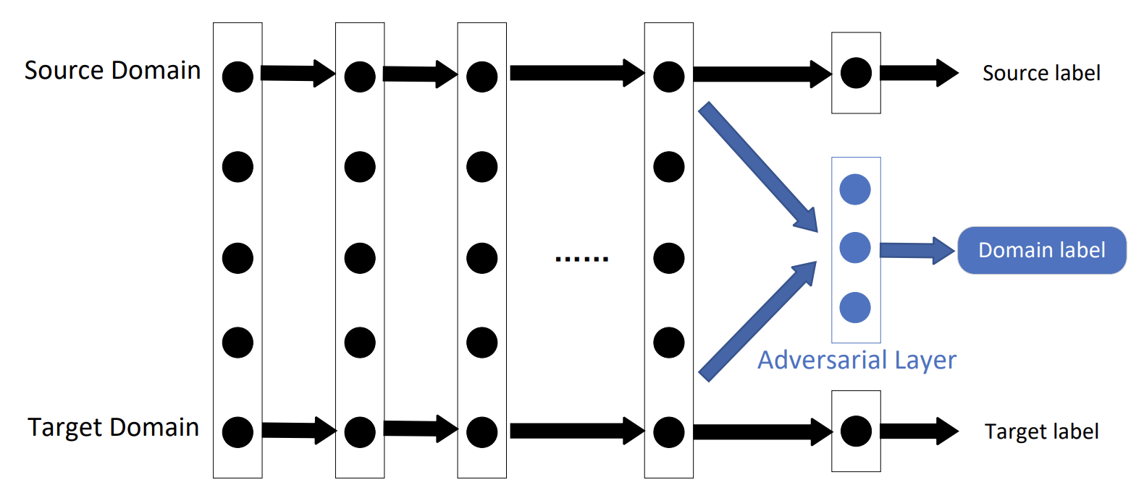
Approach Categories
Adversarial-based

Slide 11
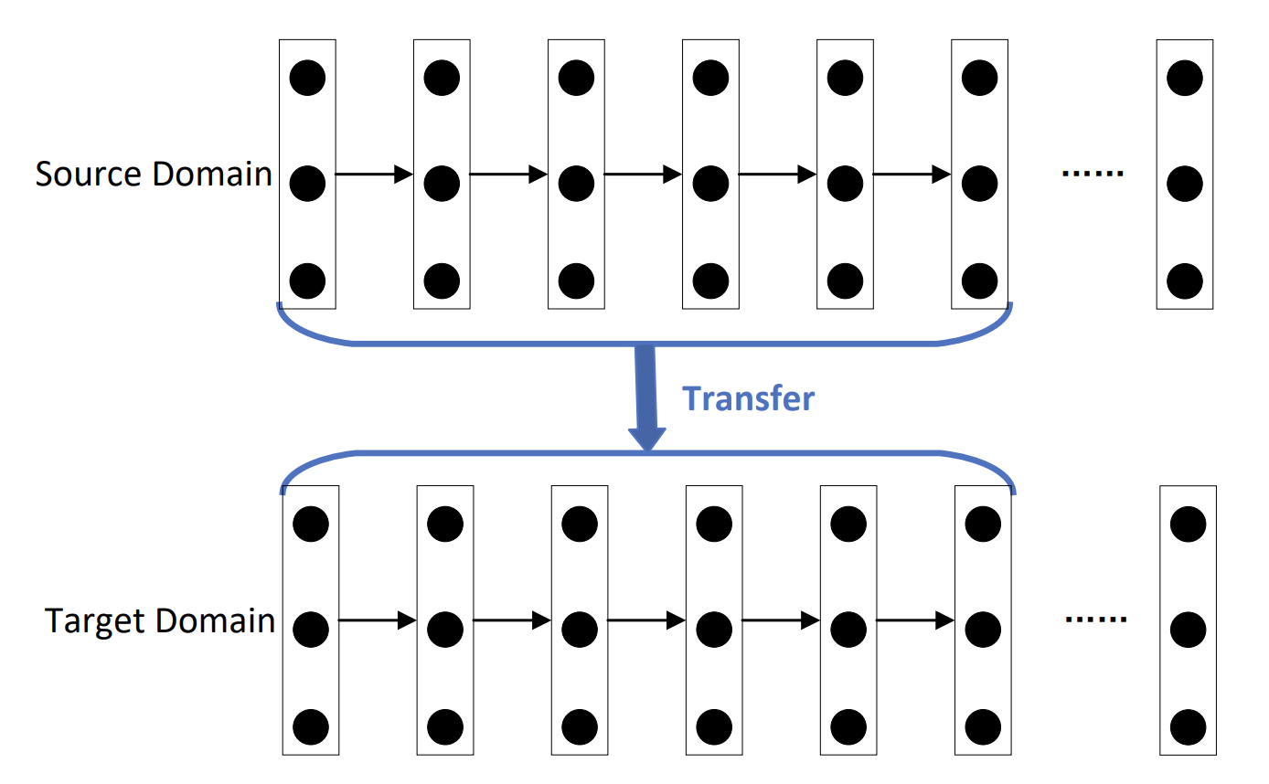
Approach Categories
Network-based

Slide 12
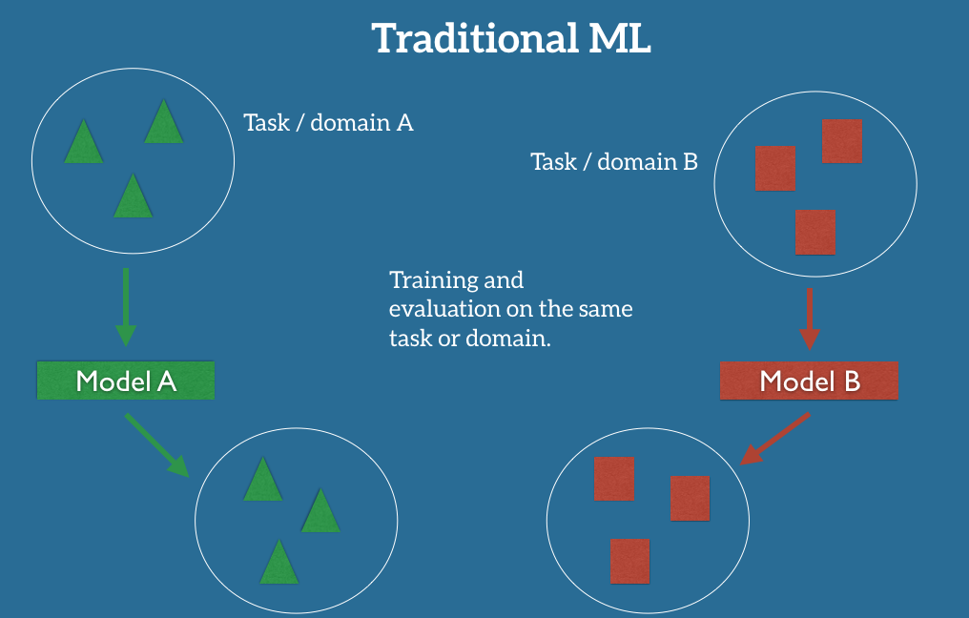
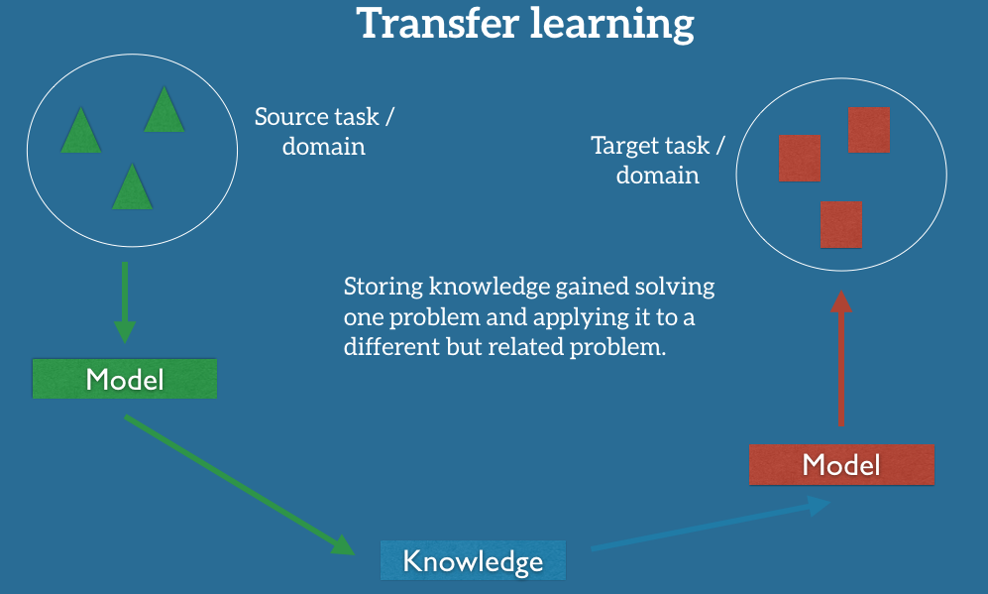
Deep Neural Networks
Traditional vs Transfer
Notes:
For the moment,

Slide 13
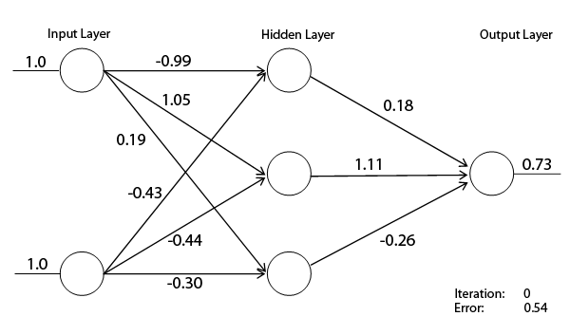
Deep Neural Networks
Learning Knowledge

Slide 14
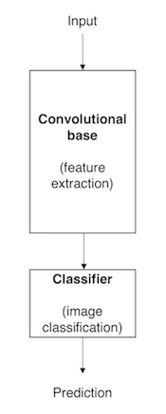
Deep Neural Networks
Convolutional Classifier
A typical CNN Classifier has two parts:
Convolutional Base: Composed by a stack of convolutional and pooling layers.
Classifier: Composed by fully connected layers.

Slide 15
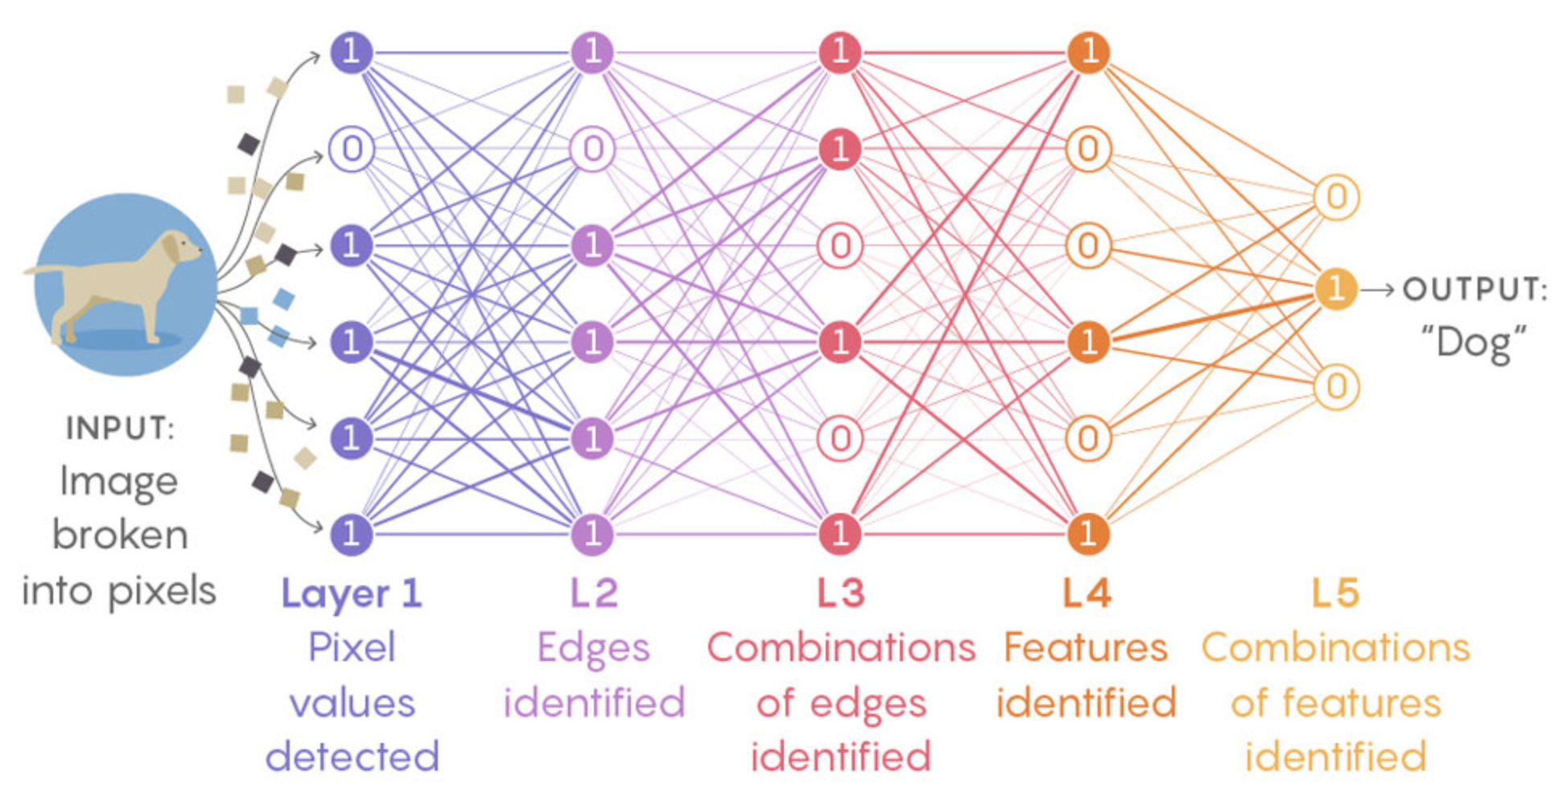
Deep Neural Networks
Layers Knowledge

Slide 16
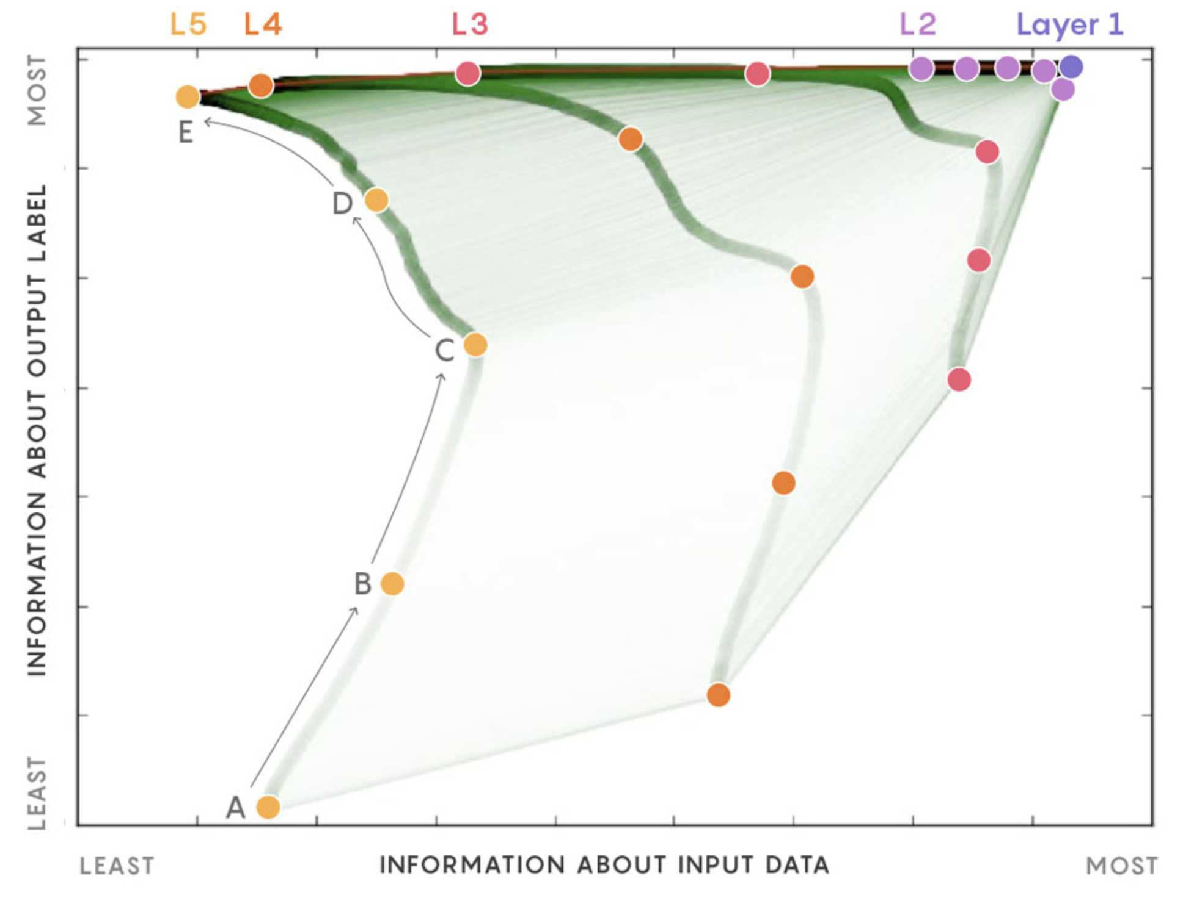
Deep Neural Networks
Layers Knowledge Evolution
Initial State
Fitting Phase
Phase Change
Compression Phase
Final State

Slide 17
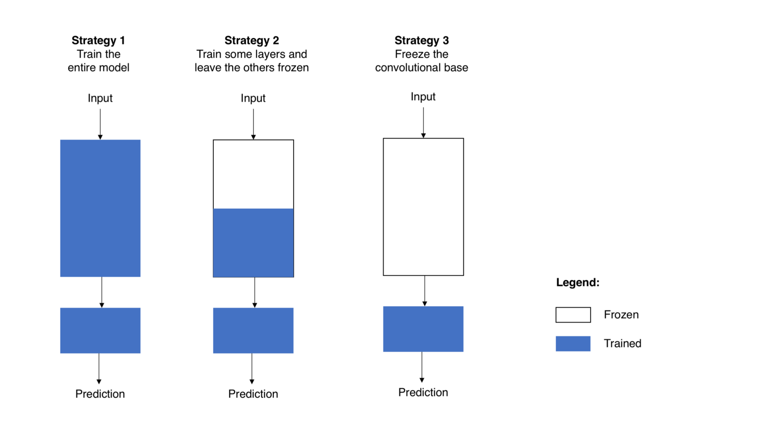
Convolutional Based Transfer
Fine-Tuning Strategies

Slide 18
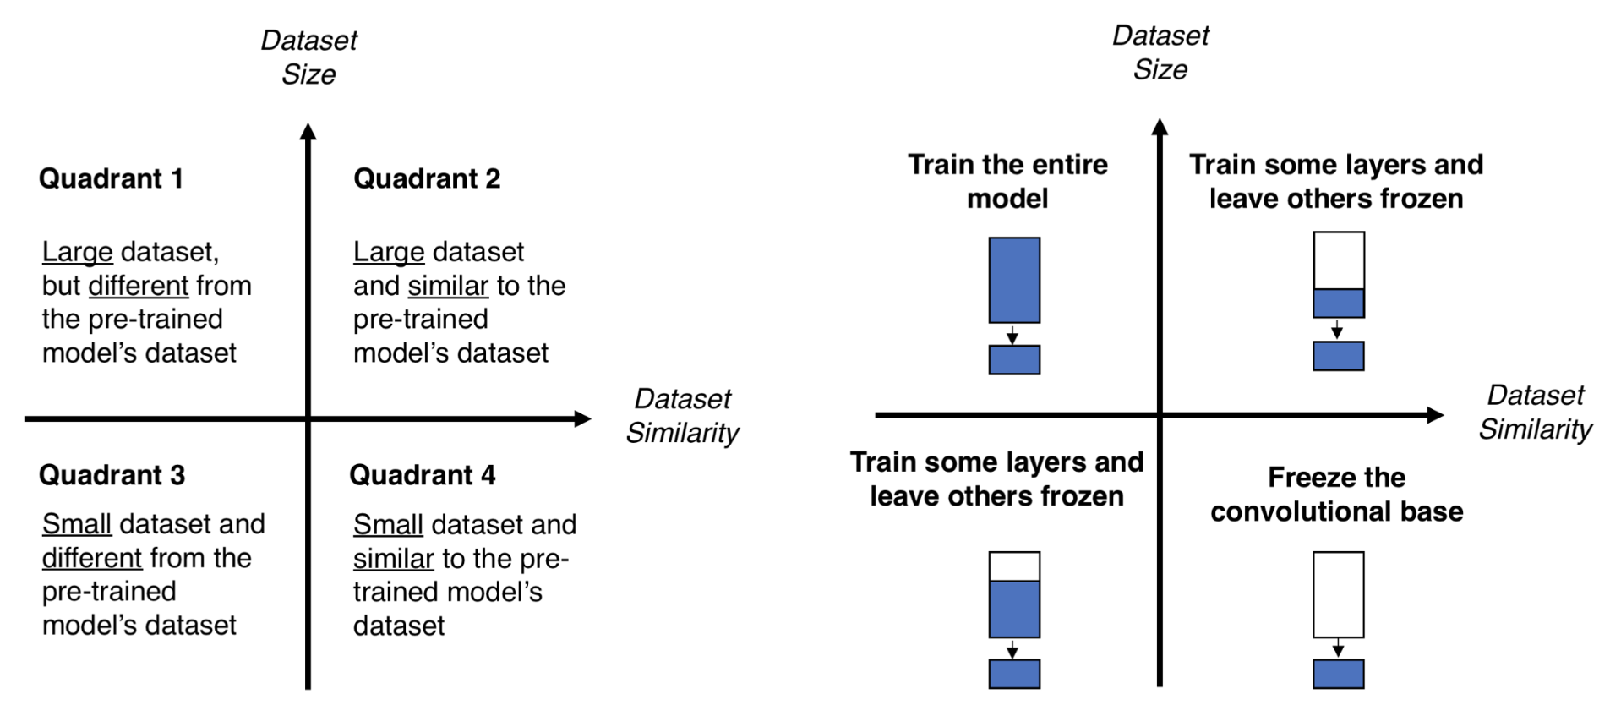
Convolutional Based Transfer
Fine-Tuning Matrix

Slide 19
Convolutional Based Transfer
Notebooks
Transfer Learning Quadrant 2 Strategy
Transfer Learning Quadrant 4 Strategy
Layers Knowledge Visualisation

Slide 20
References
Transfer Learning - Machine Learning’s Next Frontier
A Gentle Introduction To Transfer Learning For Deep Learning
Transfer Learning
A Survey On Deep Transfer Learning
Transfer Learning From Pre-trained Models
New Theory Cracks Open the Black Box of Deep Learning
Using Convnets With Small Datasets
Using A Pre-trained Convnet
Visualising What Convnets Learn

Slide 21
Q & A

